Slide 1
Diagnostic Imaging

Slide 2
Virtual follow up
This feature of SoftVue is analogous to spot compression in mammography
But without compression
And without an additional exam

Slide 3
How does it work?
In waveform tomography, IQ improves with the number of iterations/frequencies
Pressure measurements are made early in the algorithmic process
Saving them would allow the reconstructions to be repeated at a later date using more computation time
The following slides show the improvement in resolution that can be achieved

Slide 4
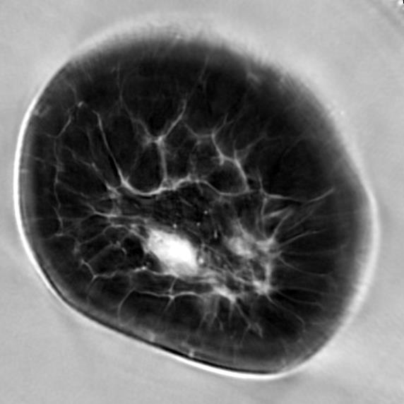
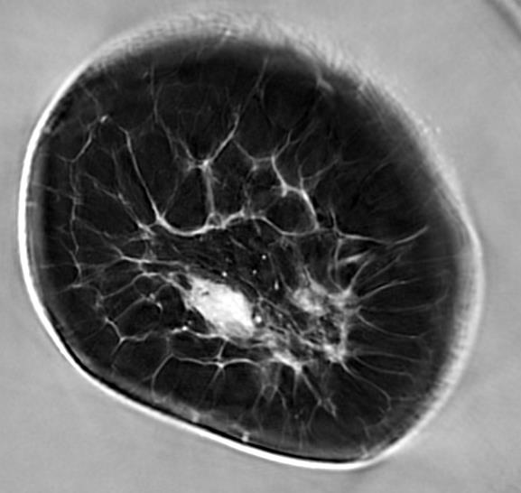
Enhanced Resolution
Fatty breast
Image from screening mode
Image from diagnostic mode

Slide 5
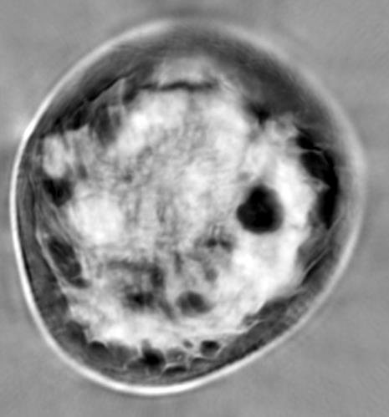
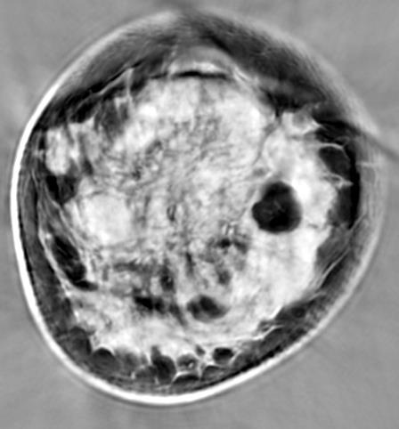
Enhanced Resolution
Dense breast
Image from screening mode
Image from diagnostic mode

Slide 6
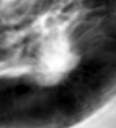
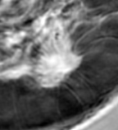
Better visualization of cancer
Possible cancer
Cancer confirmed by clear
visualization of spiculations

Slide 7
Summary
  PoC demonstrates that higher resolution, higher IQ images can be generated after the fact.
  In dense breasts (BIRADS d), resolution in sound speed is improved by about a factor 2.
  No return visit required – follow up imaging is performed offline
  Virtual diagnostic imaging is feasible

