Slide 1
Breast Cancer Detection

Slide 2
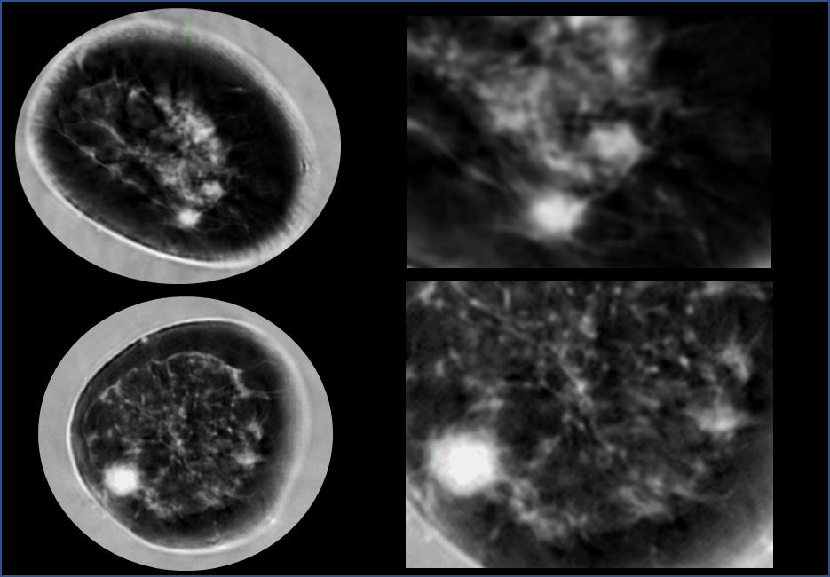
Ca location and implications for screening with UST
The fat -glandular
Interface (FGI)
FGI
FGI

Slide 3
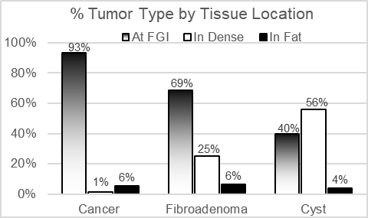
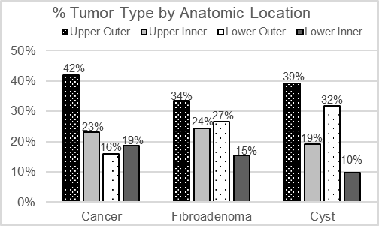
Results
Cancers were classified at the FGI in 93.3% (169/181) (p<0.001)
56.1% of cysts, 25.0% of fibroadenomas and 1.1% of cancers fully surrounded by dense tissue (p<0.001).
Clinical Implications: Optimize reads for more efficient workflow compared to quadrant search

