Slide 1
Monitoring Neoadjuvant Chemotherapy
Predicting pathologic response with SoftVue

Slide 2
The Clinical Problem
14,000 women in the U.S. undergo neoadjuvant chemotherapy for locally advanced breast cancer annually.
Predicting response early in the treatment cycle would decrease mortality and morbidity rates.
  Hypothesis: Tumor sound speed and volume are quantitative biomarkers that can be used to predict response soon after the start of neoadjuvant chemotherapy.
  Motivated by following observations
    tumor size changes observed in standard Imaging
    tumor softening deduced from manual palpation.
    changes in tumor sound speed and volume can be accurately measured and quantified with SoftVue
    SoftVue scans can be performed weekly
      up to 25 scans or more per patient!
Notes:
Standardize bullets

Slide 3
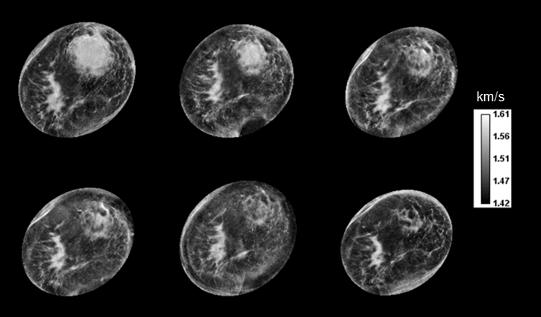
Visualizing tumor changes with high resolution
Notes:
3
Sound speed and volume

Slide 4
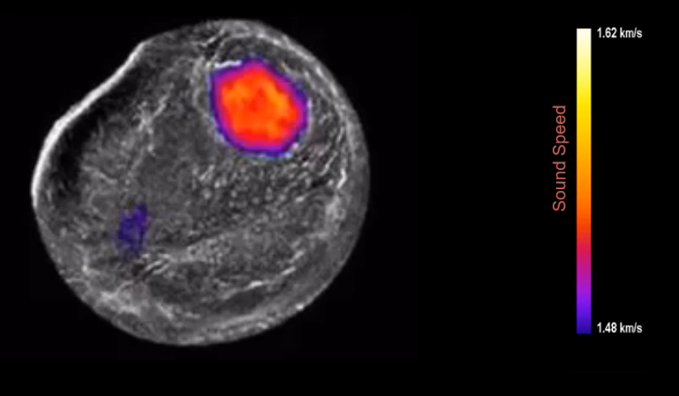
Time Lapse of Complete Response

Slide 5
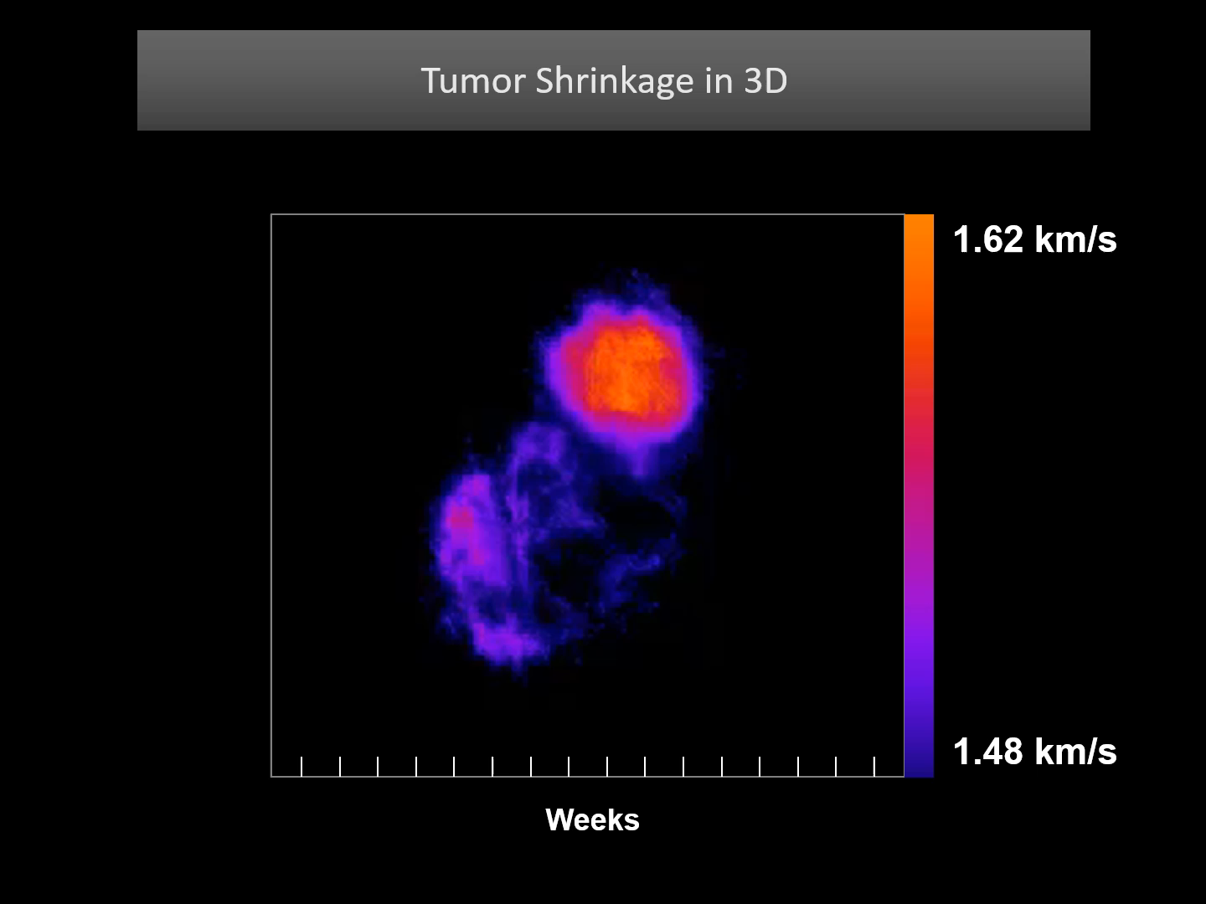

Slide 6
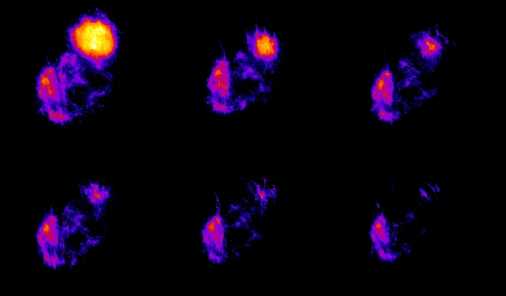
Tumor Shrinkage in 3D
1.62 km/s
Week 1
Week 4
Week 7
Week 9
Week 13
Week 16
1.48 km/s

Slide 7
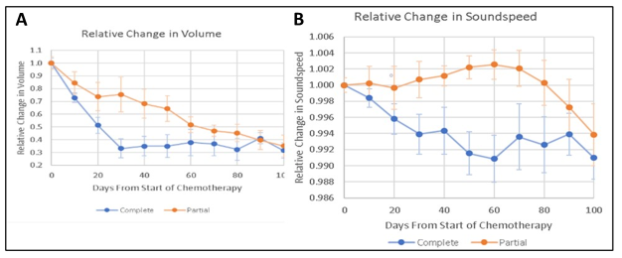
Quantitating changes in volume (V) and sound speed (VASS)
Average tumor volume change
in the complete response group (blue)
vs the partial responders (orange).
Average tumor sound speed change in the complete response group (blue) vs the partial responders (orange).
Notes:
7
Sound speed and volume

Slide 8
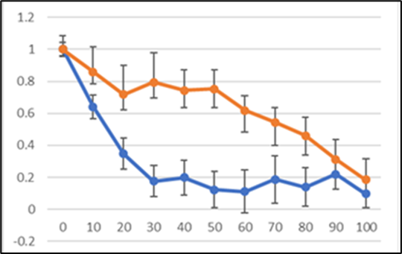
Changes in γ parameter
Potential for early prediction of pathologic complete response
Differences apparent in first 10 days
γ
Time (days)
γ = V x VASS
Notes:
8
Sound speed and volume

Slide 9
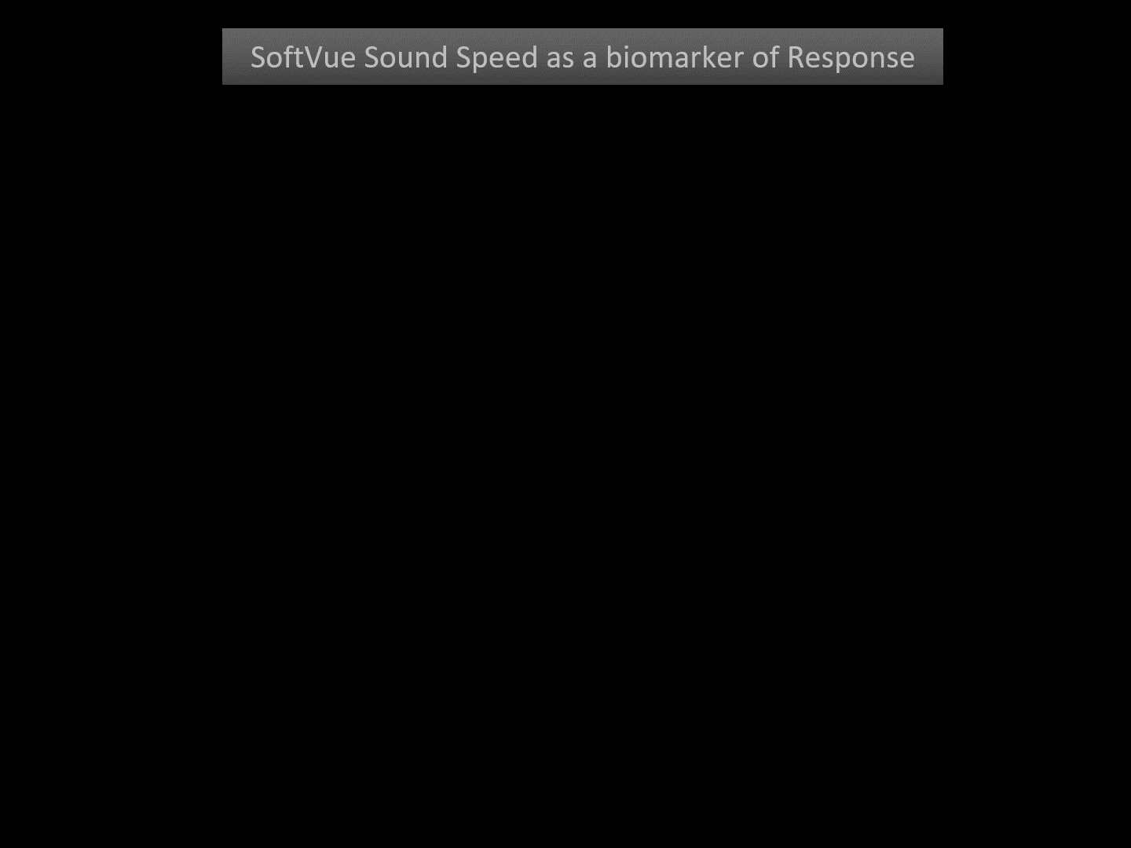

Slide 10
Conclusions
SoftVue can measure response during Neoadjuvant Chemotherapy
  Clinical response can be seen after 1 week.
  Pathologic response can be predicted after 2 weeks
SoftVue enables unprecedented measurement frequency of tumor regression
  Daily/weekly scanning intervals possible
  Up to 25 scans per patient demonstrated
Clinical Implications
  Identify non-responders, early, for alternate treatment
  Encourage responders to stay on chemo cycles
Notes:
colors

