Slide 1
SoftVue quantifies treatment response
Delphinus Medical Technologies
Notes:
Predicting outcomes for patients undergoing cancer treatment is very difficult. A major stumbling block is the lack of inexpensive monitoring tools during treatment. In this study we assessed the ability of SoftVue imaging to provide such monitoring and to predict response.

Slide 2
Motivation
Currently no way to predict who will respond to Tamoxifen.
Identifying responders and non-responders early in the treatment process will eliminate over treatment
Notes:
The specific clinical problem being addressed in this study is to predict response of patients who have been treated for breast cancer and are taking the drug Tamoxifen to prevent recurrence. It is known that about half of women taking Tamoxifen respond favorably to the drug while the other half does not. A useful surrogate marker for such response is change in breast density. The gold standard for measuring breast density is mammography. However, since mammographic imaging can at most e carried out annually there is at a year long delay in measuring the response. This represents a year or longer long delay in carrying out an intervention, either to take a non-responder off the drug an doffer an alternate strategy or encourage the responders to put up with the side effects of the drug. The frequency of mammographic imaging is limited by its use of ionizing radiation. SoftVue has no such limitation. Detection of early changes in breast density would afford women with a much smaller time period in which to decide whether to stay on the drug or explore other options.

Slide 3
Results
SoftVue Sound Speed measures response within the first 3 months of treatment initiation
Notes:
Study design: 75 cases imaged 4 times over a 1 year period. 150 controls imaged twice over a 1 year period. The average change in breast density as measured by SoftVue’s VASS tool was then used to calculate baseline, 2 month, 6 month and 2 month breast density for cases and baseline and 12 month breast density for controls. The average breast density at each point was then calculated by averaging the 50 cases and the 150 controls separately. The results are presented in the next slide.

Slide 4
SoftVue Sound Speed as a biomarker of Response
Case Control
Study
Controls
(N=74)
(N=150)
Cases
ACKNOWLEDGMENTS: This research was supported by the National Cancer Institute through contract number: NCI TAM 332298/030470
Notes:
In TAM study, control group was imaged baseline and 12 months. The cases every 3 months. The results suggest declines are discernible as early as 3 months. Also, denser breasts show greatest change.

Slide 5
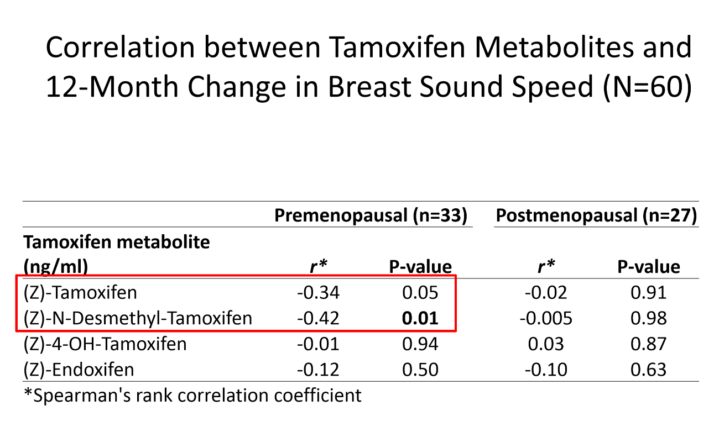

Slide 6
Conclusions
  Potential for rapid treatment monitoring
    Better manage 5 year commitment to treatment
    Provide feedback to encourage treatment compliance
    Identify groups that won’t benefit from the 5 year commitment to treatment

