Slide 1
Predicting Breast Cancer Risk with SoftVue
Delphinus Medical Technologies

Slide 2

Unmet need
Women with dense breasts are much more likely to develop breast cancer but mammography is too crude to provide accurate assessment of risk
Women with dense breasts are more likely to have cancer missed on mammography but lack of accurate risk assessment limits guidance for alternative imaging.
Women under 40 have no avenue for assessing their breast density and are not eligible for mammography and therefore no risk assessment.
70 million women in the US are impacted by these limitations. A more accurate risk prediction method that also works for women of all ages is urgently needed.
test

Slide 3
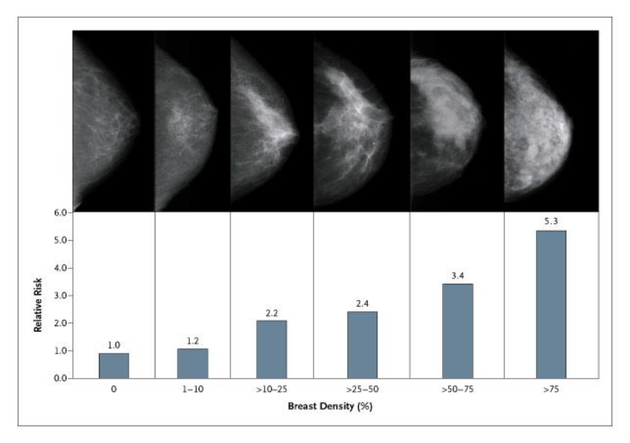
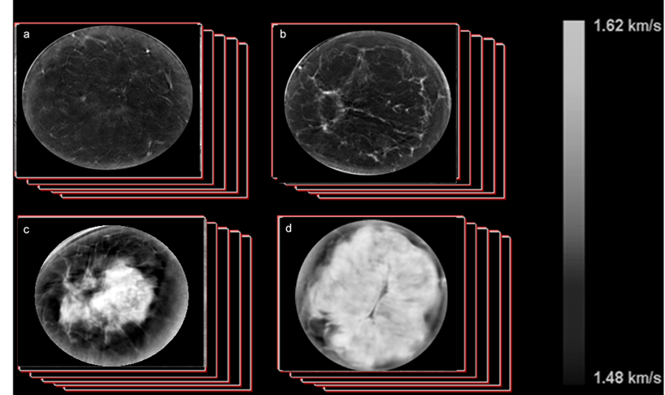





Sound speed measure of breast density has major advantages
Mammography
SoftVue
Fatty
Scattered
Fatty
Dense
2D projections of 3D Volume
Arbitrary thresholds to isolate dense tissue
Heterogenous
Dense
No quantitative pixel values
3D Volume estimate
No arbitrary thresholds required
Single absolute number quantifies density
Notes:
3

Slide 4
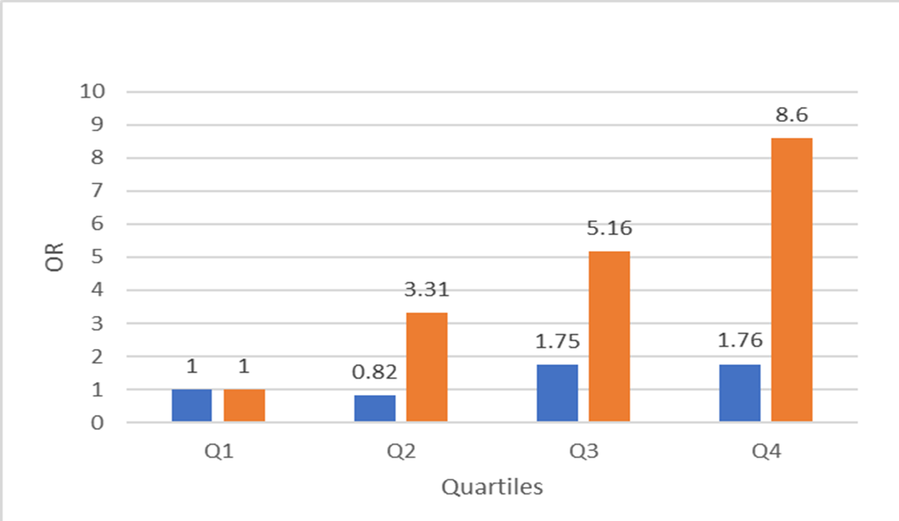
Sound speed measure of breast density as a biomarker for breast cancer risk
SoftVue
Mammography
 | Mammo | SoftVue
P value | p=0.15 | p=0.0003
74 study subjects with recently diagnosed breast cancer and 150 healthy controls were recruited to this study
The SoftVue measurements show strong, statistically significant risk gradient while mammography does not.
NCI Case Control Study of Relative Risk
There is a trend for incidence of cancer to increase with increasing mammographic percent density and volume averaged sound speed.
Odds Ratios
Density Bins

Slide 5
Conclusions
SoftVue sound speed is more strongly associated with breast cancer risk than mammography.
SoftVue is an attractive alternative to mammography
  No compression
  No radiation
  More accurate
  test

