Slide 1
SoftVue Quantifies Breast Density
Delphinus Medical Technologies
Notes:
This video describes how SoftVue can quantify breast density. Motivated by the importance of breast density in detection and risk assessment.

Slide 2
Motivation
Breast density linked to cancer risk and treatment response
Improve accuracy of breast density measurements
Notes:
The gold standard for computerized breast density measurements is the Volpara system which estimates percent breast density from mammograms. The limitation of Volpara is that it cannot quantify breast density, only measure the percent of the mammogram that is occupied by dense tissue where dense tissue is defined by a threshold and therefore does not take into account the variation in density of the dense tissue itself. SoftVue, on the other hand, measures such variations and quantifies them. The final density number is provided as an absolute number using the speed of sound measurement, which is unique to SoftVue.

Slide 3
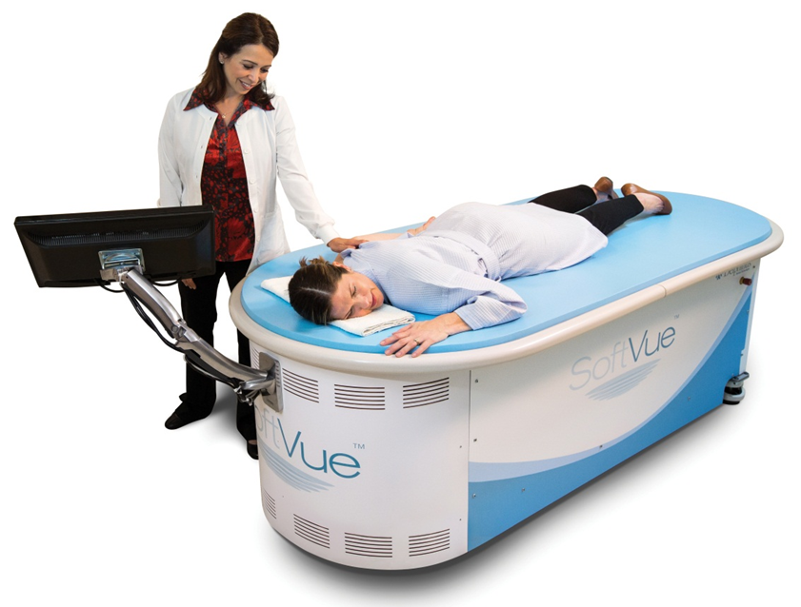
Using UST to Measure Sound Speed Marker of Breast Density
Possible because of closed transducer geometry
Notes:
How does SV work?
Conventional reflection ultrasound exploits differences in acoustic impedance between tissue types to provide anatomical images of breast tumors [61-62]. However, reflection is just one aspect of a multi-faceted set of acoustic signatures associated with the biomechanical properties of tissue. UST is a technique that moves beyond B-mode imaging by virtue of its transmission capabilities. The latter provides additional characterization by measuring tissue parameters such as sound speed and attenuation [63-67]. These parameters can be used to characterize lesions in a quantitative manner, a capability not available in current whole breast ultrasound systems. By merging reflection images with images of the bio-acoustic parameters of sound speed and attenuation, UST offers the possibility of exploiting differences in anatomical and physical properties of tissue to accurately differentiate cancer from normal tissue or benign disease. UST parameters are also quantitative, which allows new consideration of second and third-order statistical image analyses, or radiomics. Ultrasound has previously not been suitable for the burgeoning applications of radiomics due to its lack of true quantitative parameters, such as sound speed (m/sec) and attenuation (dB/cm/MHz).
SoftVue embodies a number of attributes that differentiate it from conventional US:
Water based pulse coupling: SoftVue utilizes a water filled imaging chamber that is kept at body temperature. Its primary purpose is to couple the sound energy between the transducer and the breast tissue.
Closed geometry probe: A circular ring transducer surrounds the breast while both are immersed in water. There is no compression of the breast since the transducer is offset from the breast with water acting as the pulse coupling agent. The closed transducer geometry allows collection of signals that pass through the entire width of the breast, a requirement for transmission imaging and the reconstruction of sound speed and attenuation images. These parameters provide quantitative information in absolute units that are tied to externals standards (km/sec and dB/cm respectively). SHOW VIDEO.
Operator independence: Unlike mammography and other ABUS systems, multiple positionings are not required for larger breasts. Once the patient is positioned on the table (REFRE TO FIGURE), the operator simply presses the button and the exam is performed automatically without further intervention from the operator.
Scan time: SoftVue scan time is 1 to 2 minutes per breast (depending on breast size). This scan duration minimizes intra-slice and inter-slice motion artifacts.
Image reconstruction time.. Reconstruction time for a bilateral breast exam 15 - 30 minutes depending on the size of the breast.
Other attributes: REFER TO BULLET POINTS.

Slide 4
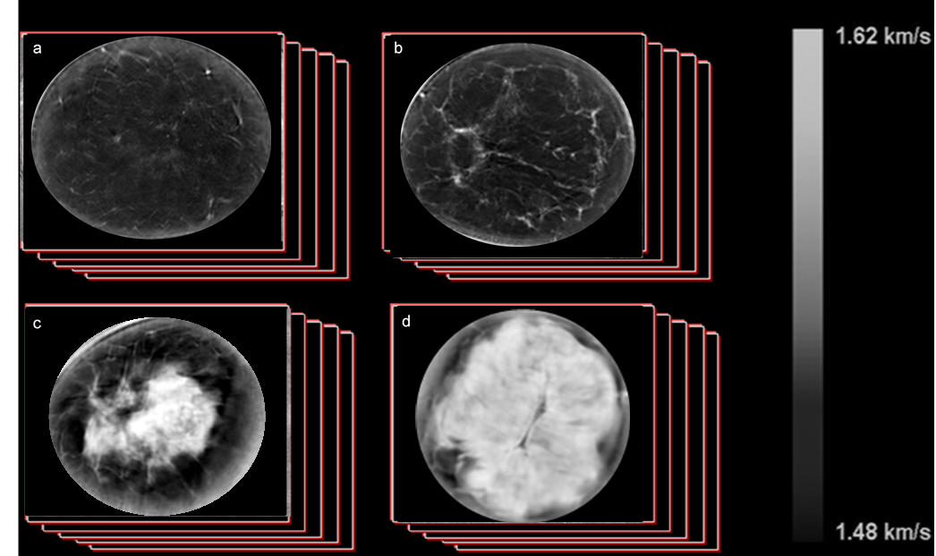
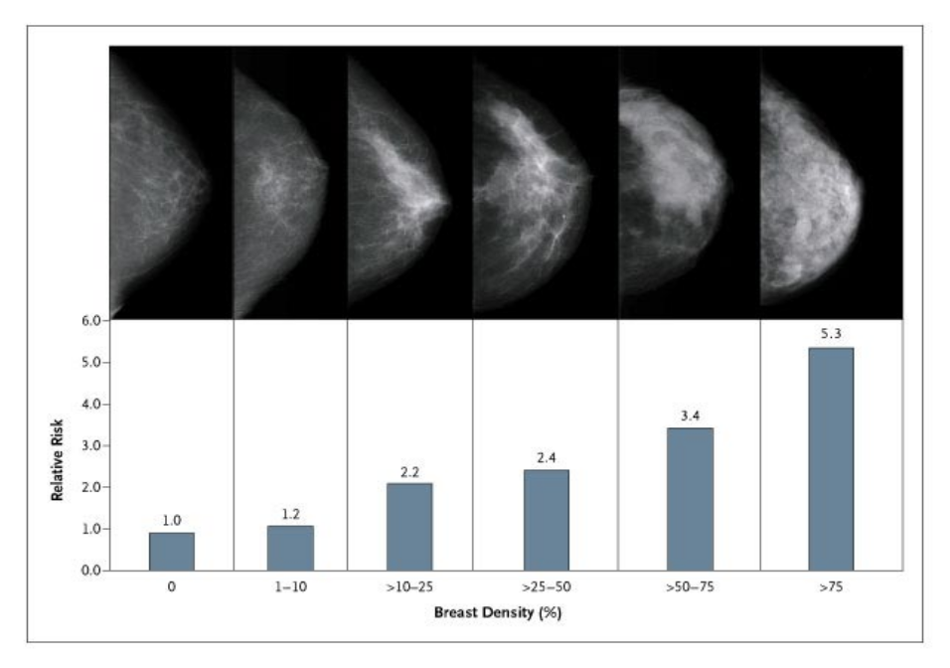
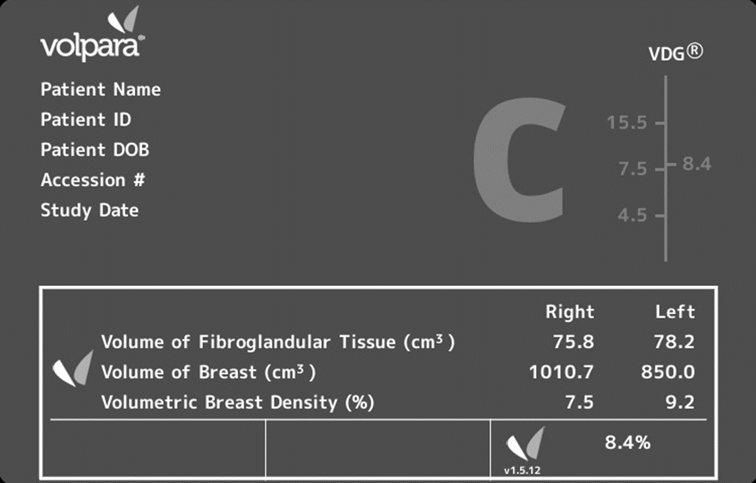
Sound Speed Measure of Breast Density as a Marker for Breast Cancer Risk
Mammography
UST
Santen, R J, Mansel, R. 2005.
Boyd, N. et al, 2007
Volumetric sound speed (km/s)
Volumetric sound speed (%)
Notes:
4
Steeper risk gradient may be possible because UST is 3D + Quantitative + more closely linked to density, unlike mammography which is tied to X-ray absorption properties, 2 D projections and percentages.

Slide 5
Methods
SoftVue vs Volpara
A group of 100 women underwent both a UST scan and a mammogram at the Karmanos Cancer Institute (KCI)
The mammograms had their density analyzed using Volpara
SoftVue scans that occurred within 1 year of the mammogram were analyzed for breast density
At time of the SoftVue scan, sound speed images were created for this study
SoftVue percent density and absolute sound speed were calculated for the breast volume of each patient
The percentage densities and VASS of the SoftVue measurements were compared with Volpara percent densities
Correlation coefficients were determined to assess the degree of agreement.
Notes:
We now describe the methods used.

Slide 6
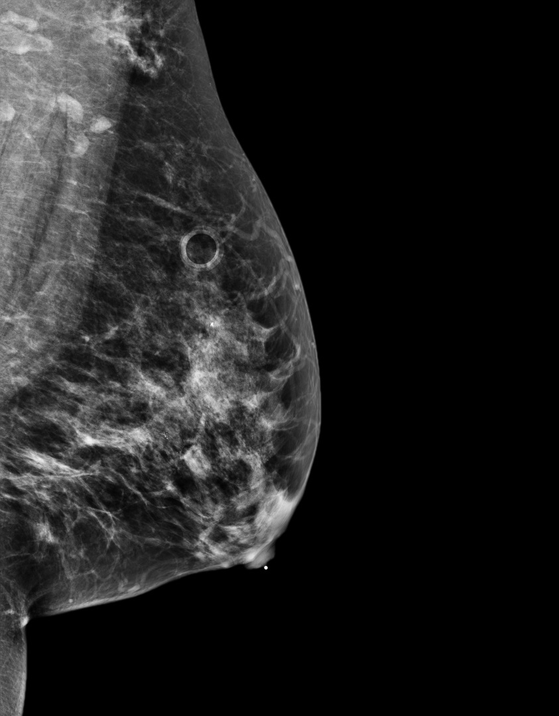
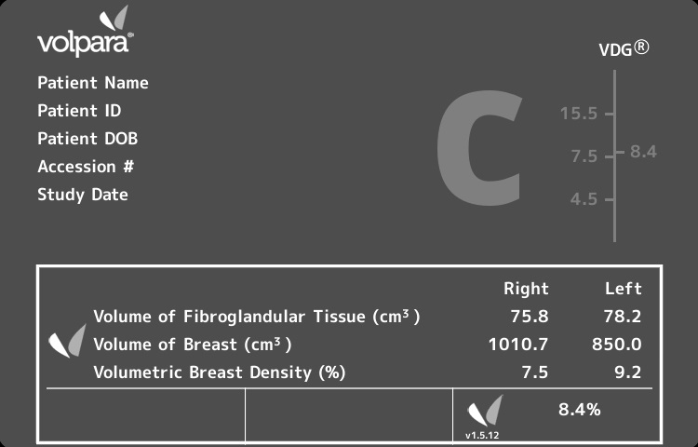
Volpara Density Measurements
Notes:
Typical example of Volpara output. Showing the various parameters that characterize the breast.

Slide 7
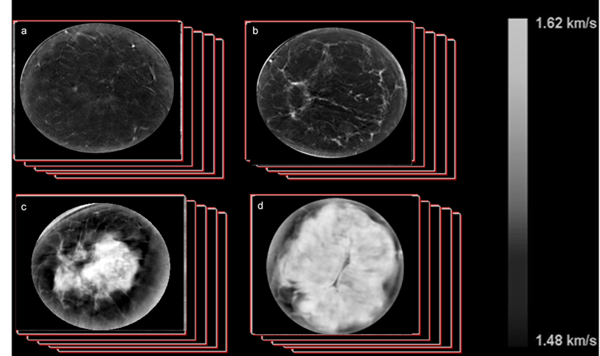
Sound speed measure of breast density as a biomarker for breast cancer risk
Fatty
Scattered
SoftVue
Heterogenous
Dense
Fat (black)
Glandular tissue (white)
Notes:
7
Steeper risk gradient may be possible because UST is 3D + Quantitative + more closely linked to density, unlike mammography which is tied to X-ray absorption properties, 2 D projections and percentages.

Slide 8
Results - SV vs Volpara Density Measures
Correlation | Spearman Coefficient
Mean SoftVue Sound Speed versus Volpara Percent Density | 0.848
SoftVue Percent Density versus Volpara Percent Density | 0.859

Slide 9
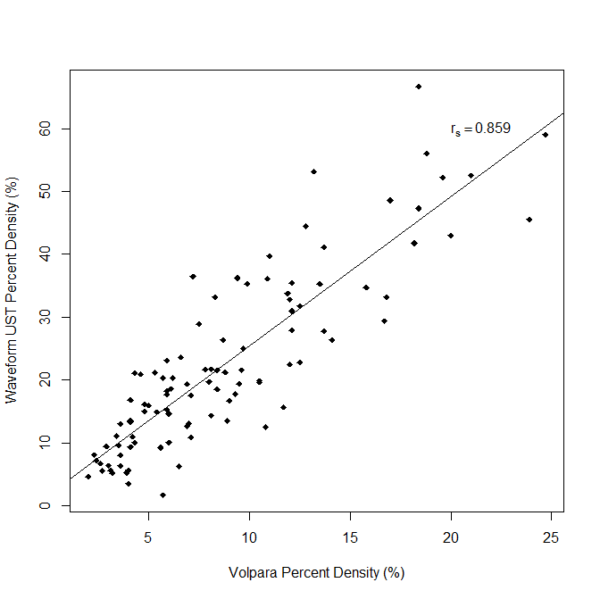
Results - SV vs Volpara Density Measures
SoftVue PD versus Volpara PD
r_{s} = 0.859

Slide 10
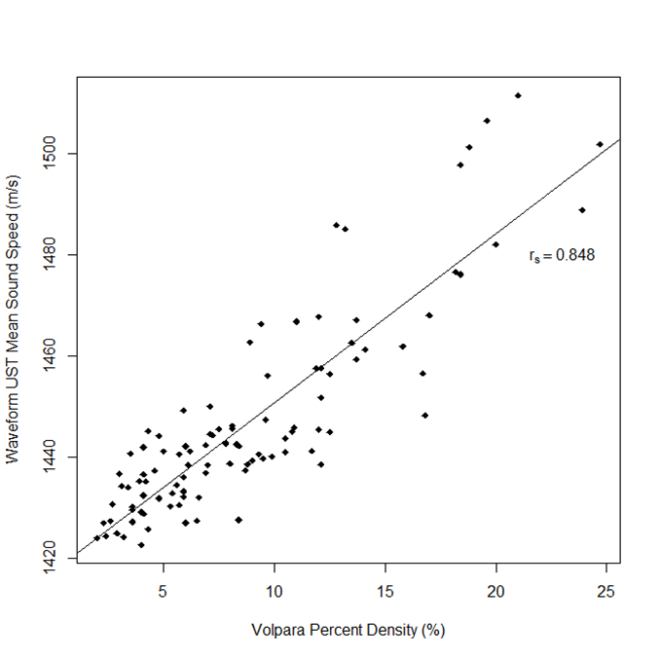
Results - SV vs Volpara Density Measures
SoftVue VASS versus Volpara PD
Quantitative values – not percentages
r_{s} = 0.848

Slide 11
Conclusions
SV sound speed imaging is effective at visualizing and quantifying distributions of dense tissue throughout the breast.
Volpara volumetric breast density measures correlate strongly with SV sound speed density measures.
→
  SV’s volume averaged speed of sound (VASS) is an absolute quantitative marker of breast density
  SV’s percent density is an alternative marker of breast density

