Slide 1
Monitoring Neoadjuvant Chemotherapy
Predicting pathologic response with SoftVue

Slide 2
The Clinical Problem
14,000 women in the U.S. undergo neoadjuvant chemotherapy for locally advanced breast cancer annually.
Predicting response early in the treatment cycle would decrease mortality and morbidity rates.
  Hypothesis: Tumor sound speed and volume are quantitative biomarkers that can be used to predict response soon after the start of neoadjuvant chemotherapy.
  Motivated by following observations
    tumor size changes observed in standard Imaging
    tumor softening deduced from manual palpation.
    changes in tumor sound speed and volume can be accurately measured and quantified.
Notes:
Standardize bullets

Slide 3
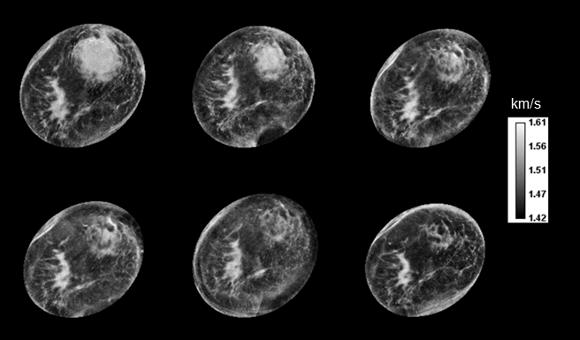
Visualizing tumor changes with high resolution
Notes:
3
Sound speed and volume

Slide 4
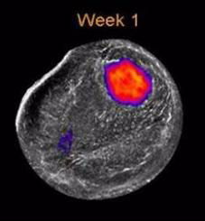

Time Lapse of Complete Response
Sound Speed

Slide 5
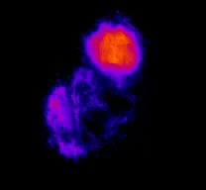
Tumor Shrinkage in 3D
1.62 km/s
Mass
Dense tissue
1
4
7
9
13
16
1.48 km/s
Weeks

Slide 6
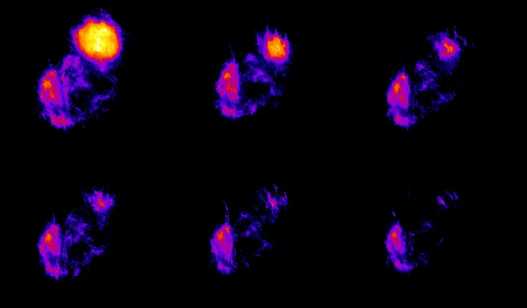
Tumor Shrinkage in 3D
1.62 km/s
Week 1
Week 4
Week 7
Week 9
Week 13
Week 16
1.48 km/s

Slide 7
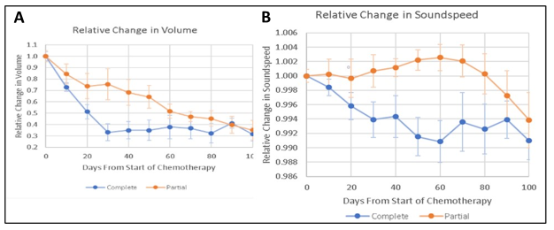
Quantitating changes in volume (V) and sound speed (VASS)
Average tumor volume change
in the complete response group (blue)
vs the partial responders (orange).
Average tumor sound speed change in the complete response group (blue) vs the partial responders (orange).
Notes:
7
Sound speed and volume

Slide 8
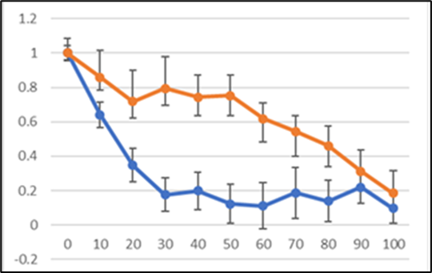
Changes in γ parameter
Potential for early prediction of pathologic complete response
Differences apparent in first 10 days
γ
Time (days)
γ = V x VASS
Notes:
8
Sound speed and volume

Slide 9
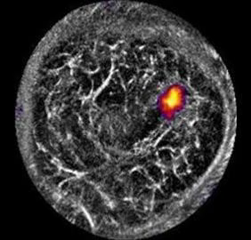
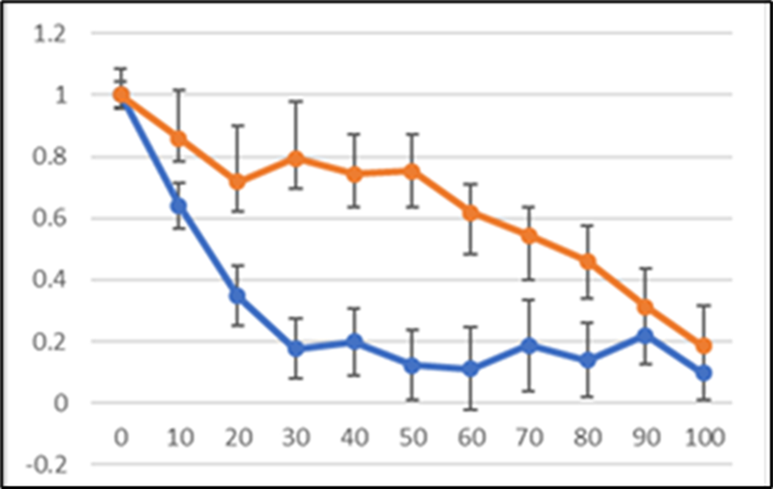
SoftVue Sound Speed as a biomarker of Response
Complete responders
vs
Partial responders
Partial
Complete
Notes:
In TAM study, control group was imaged baseline and 12 months. The cases every 3 months. The results suggest declines are discernible as early as 3 months. Also, denser breasts show greatest change.

Slide 10
Conclusions
SoftVue can measure response during Neoadjuvant Chemotherapy
  Clinical response can be seen after 1 week.
  Pathologic response can be predicted after 2 weeks
Clinical Implications
  Identify non-responders, early, for alternate treatment
  Encourage responders to stay on chemo cycles
Notes:
colors

