Slide 1
Predicting Breast Cancer Risk with SoftVue
Delphinus Medical Technologies
Notes:
A woman’s risk of developing cancer increases with increasing breast density. We present evidence that shows that SoftVue is more accurate in predicting risk compared to mammography.

Slide 2

Unmet need
Women with dense breasts are much more likely to develop breast cancer but mammography is too crude to provide accurate assessment of risk
Women with dense breasts are more likely to have cancer missed on mammography but lack of accurate risk assessment limits guidance for alternative imaging.
Women under 40 have no avenue for assessing their breast density and are not eligible for mammography and therefore no risk assessment.
70 million women in the US are impacted by these limitations. A more accurate risk prediction method that also works for women of all ages is urgently needed.
test
Notes:
The gold standard for computerized breast density measurements is the Volpara system which estimates percent breast density from mammograms. The limitation of Volpara is that it cannot quantify breast density, only measure the percent of the mammogram that is occupied by dense tissue where dense tissue is defined by a threshold and therefore does not take into account the variation in density of the dense tissue itself. SoftVue, on the other hand, measures such variations and quantifies them. The final density number is provided as an absolute number using the speed of sound measurement, which is unique to SoftVue.

Slide 3
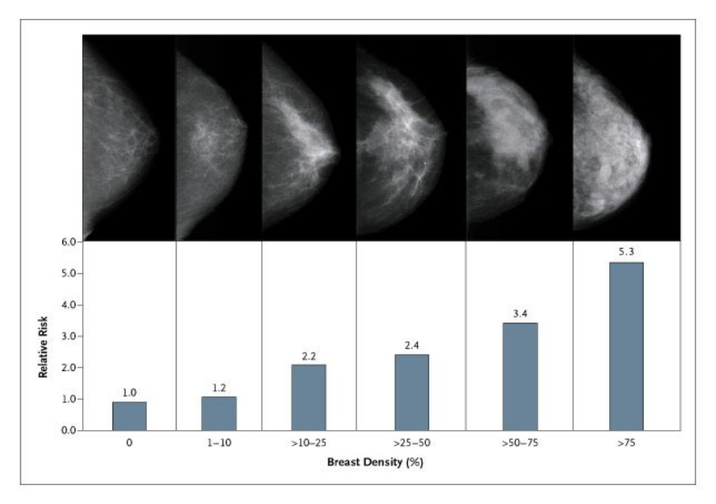
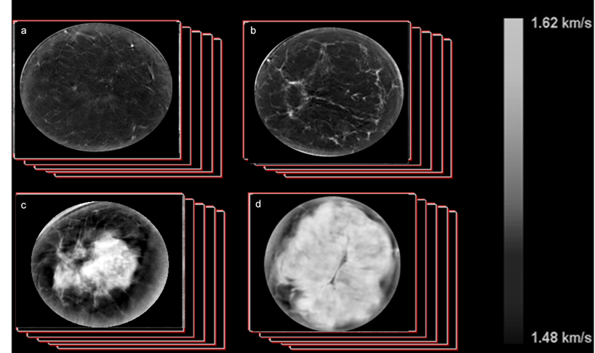





Sound speed measure of breast density has major advantages
Mammography
SoftVue
Fatty
Scattered
Fatty
Dense
2D projections of 3D Volume
Arbitrary thresholds to isolate dense tissue
Heterogenous
Dense
No quantitative pixel values
3D Volume estimate
No arbitrary thresholds required
Single absolute number quantifies density
Notes:
3
Mammography is the gold standard for measuring breast density As shown on left side of the slide. Increasing density from left to right. Many studies have shown that that risk increases strongly with density. But such measurements are limited because mammography is not a quantitative measurement it consists of 2D projections and arbitrary thresholds are needed to isolate dense tissue from fat. The technique of ultrasound tomography renders images that are volumetric, quantitative and do not require arbitrary thresholding. In this study we test the association of speed of sound with breast cancer risk to determine if these potential advantages translate into a better marker for breast cancer risk. Summary: Mammographic percent density vs volume averaged sound speed.

Slide 4
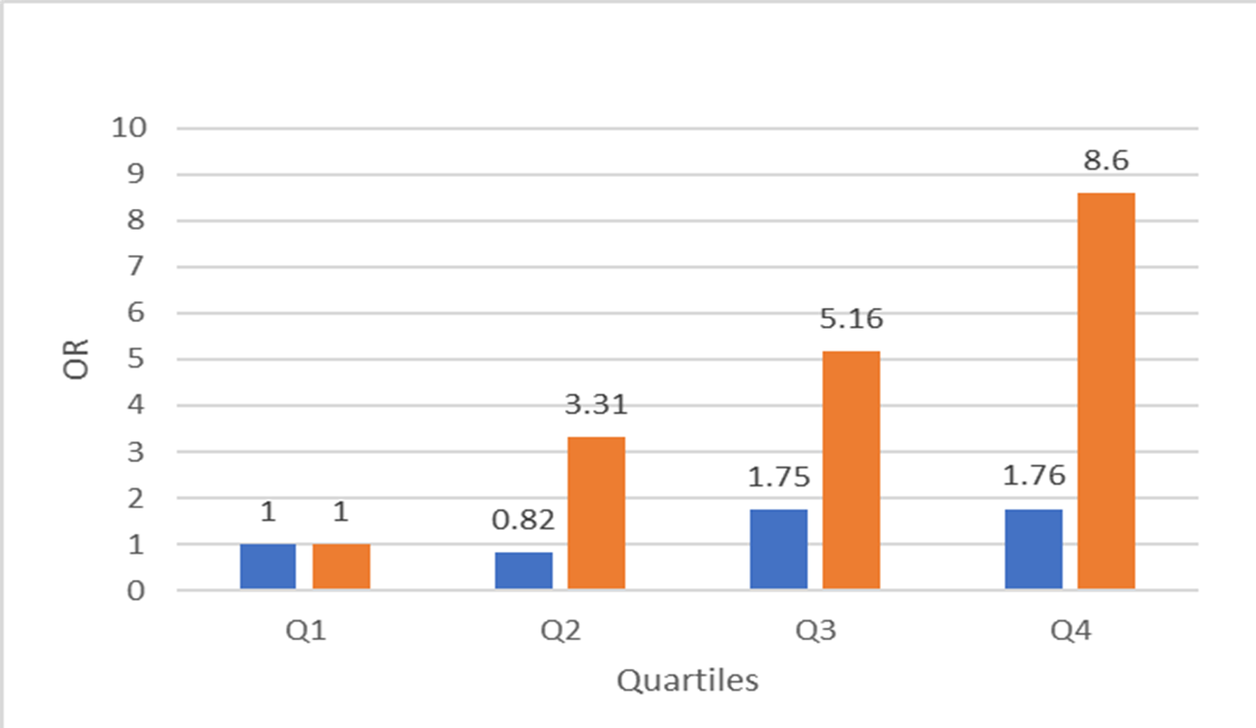
Sound speed measure of breast density as a biomarker for breast cancer risk
SoftVue
Mammography
 | Mammo | SoftVue
P value | p=0.15 | p=0.0003
74 study subjects with recently diagnosed breast cancer and 150 healthy controls were recruited to this study
The SoftVue measurements show strong, statistically significant risk gradient while mammography does not.
NCI Case Control Study of Relative Risk
As can be seen, there is a trend for incidence of cancer to increase with increasing mammographic percent density and volume averaged sound speed.
Odds Ratios
Density Bins
Notes:
We performed a case control study led by Dr. Gierach from the NCI. This work was funded by an NCI contract. 74 study subjects with recently diagnosed breast cancer and 150 healthy controls were recruited to this study. Each study subject had both a mammogram and a UST scan. The cases were imaged before onset of systemic treatment and only the contralateral breast was imaged. The control group was then divided in to quartiles of mammographic percent density and volume averaged sound speed. The cases were then placed in each quartile based on their BD values. As can be seen, there is a trend for incidence of cancer to increase with increasing mpd and ss. But different p values.

Slide 5
Conclusions
SoftVue sound speed is more strongly associated with breast cancer risk than mammography.
SoftVue is an attractive alternative to mammography
  No compression
  No radiation
  More accurate
  test

