Slide 1
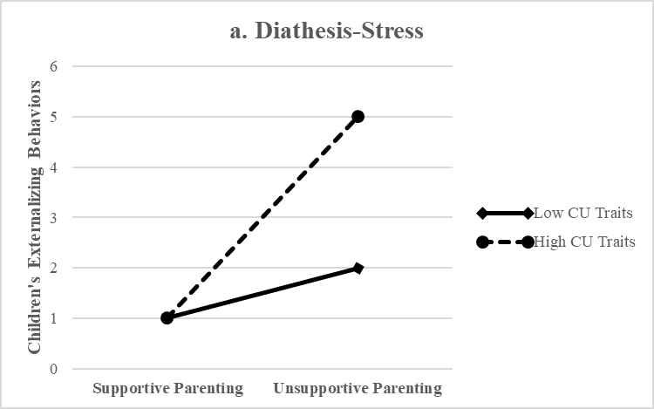
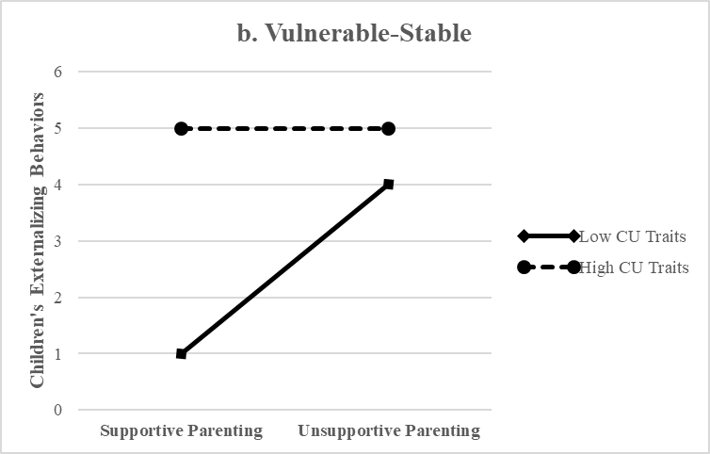
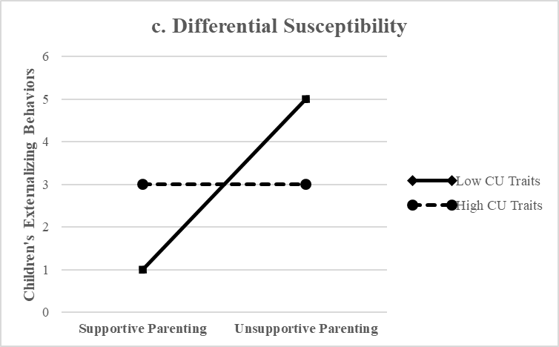


Disentangling the relationship between callousness and parenting through a developmental lens
Vanessa T. Cao, Patrick T. Davies, & Melissa L. Sturge-Apple
Aim 1: Examine whether longitudinal associations among parenting and externalizing behaviors are moderated by children’s CU traits
Participants
N = 243 children
56% girls
Age: M = 4.6 years old (SD = .44 )
Race: Black or African American (48%), White (43%), Multiracial (6%), Other race (3%)
Household Income: Median = $36,000
Aim 2: Characterize the moderating effects of CU traits
Aim 3 : Examine the domain-specificity and domain-generality of CU traits as a moderator
Retention across 2-year period between waves was 91%
Construct | Method | Reporter | Waves | Measures Description | Reliability
Unsupportive Parenting (Maternal & Paternal) | Observation | Coder | 1 | Family interaction task (Schoppe et al., 2001). 1. Warmth 2. Sensitivity 3. Disengagement | ICCs Mothers: .90-.93 Fathers: .93-.96
Children’s CU Traits | Survey | Mother | 1 | ICU (Frick, 2004) Total Score | Internal Consistency α = .82
Children’s Externalizing Behaviors | Survey | Teacher | 1 & 2 | HBQ (Ablow, 1999) 1. Oppositional defiance 2. Conduct problems 3. ADHD behaviors | ICCs across W1 & W2 .86-.94
Children’s Social Adjustment | Survey | Teacher | 1 & 2 | HBQ (Ablow, 1999) 1. Peer Acceptance 2. Teacher Closeness 3. Asocial | ICCs across W1 & W2 .80-.93

Slide 2
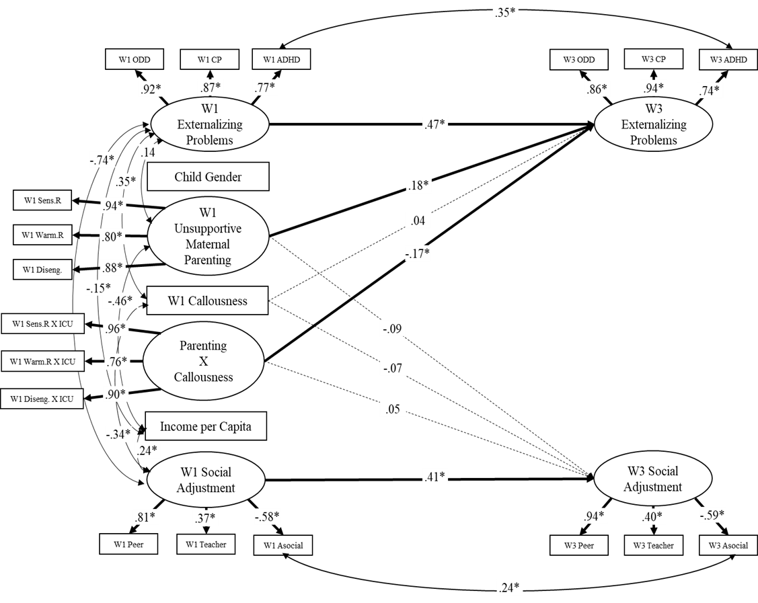
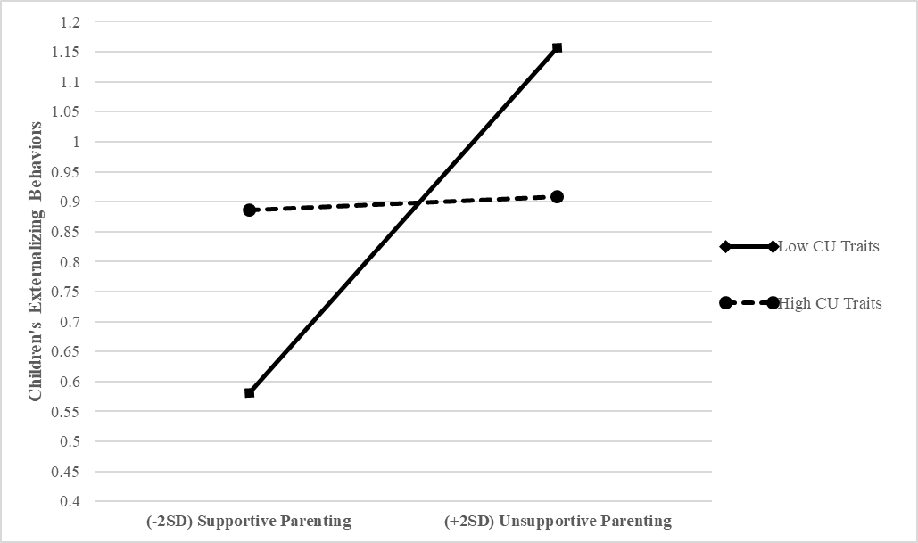
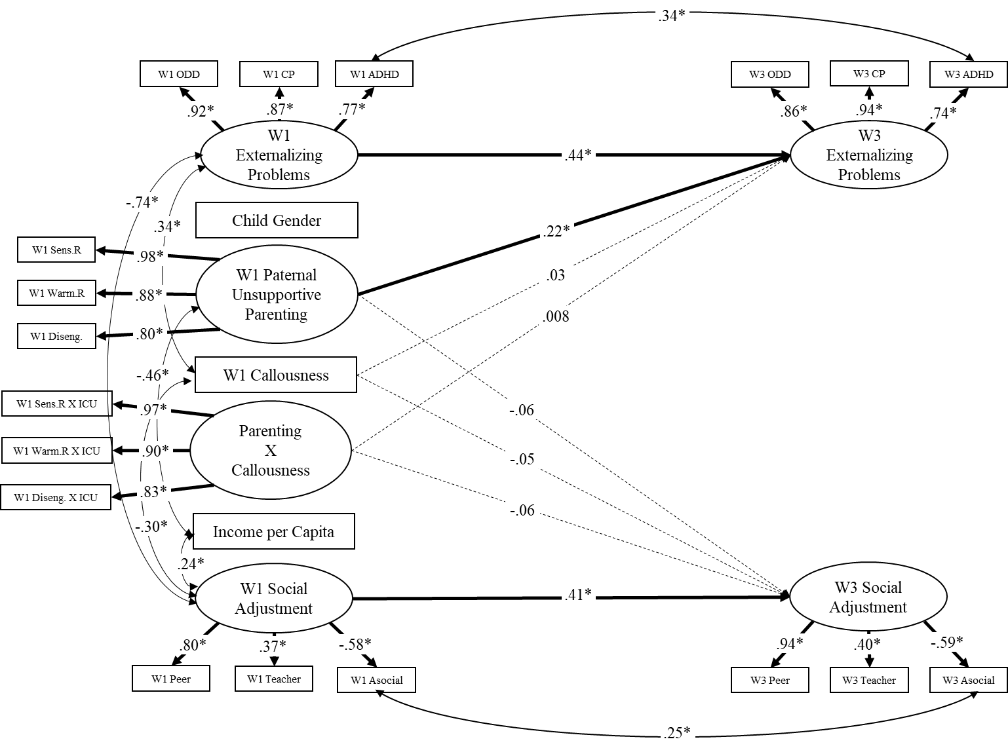
Model Fit (Mothers)
χ² (161, N = 243) = 311.73, p < .001 RMSEA = .06
CFI = .93
χ²/df ratio = 1.94
Data Analysis
Cross-lagged, autoregressive SEM
Separate models for mothers and fathers
Latent constructs
  Uns. Parenting
  Interaction
  Externalizing Behaviors
  Social Adjustment
Tests for measurement equivalence across Wave 1 and Wave 2 repeated measures
Additional Analyses
Simple slopes
RoS on Z
PoI (See green highlighted area)
Takeaways
Aim 1: CU traits moderated associations between unsupportive parenting and residualized changes in children’s externalizing problems
Aim 2: Support for differential susceptibility
  Low CU traits as a plasticity factor
Aim 3: Moderator role of CU traits on unsupportive parenting may be specific to:
  Environment: Mothers
  Sequelae: Externalizing Behaviors
Model Fit (Fathers)
χ2 (158, N = 240) = 345.75, p < .001
RMSEA = .07
CFI = .92
χ2/df ratio = 2.15

