Slide 1


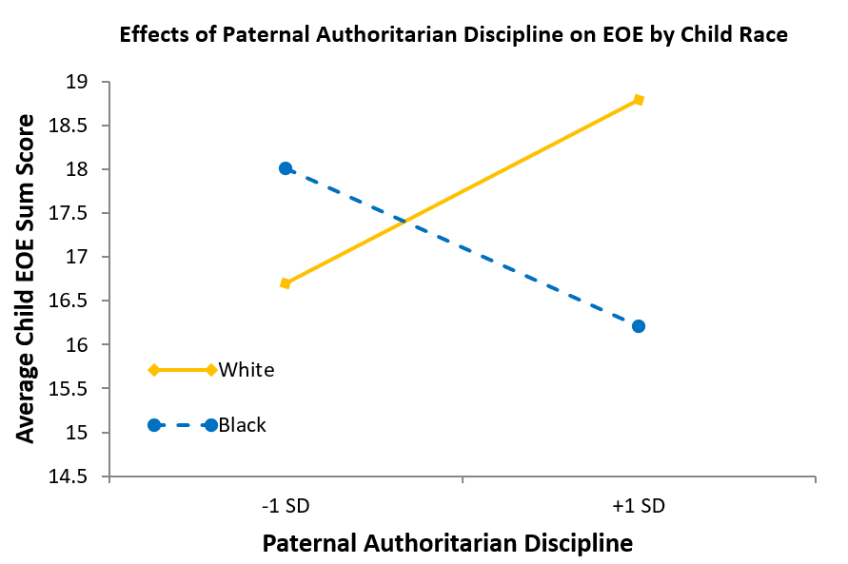
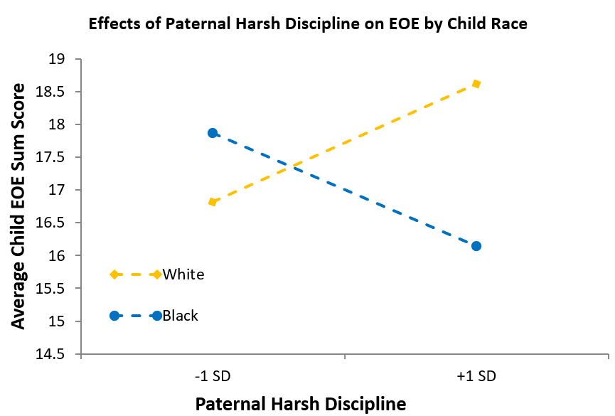
Parental Harsh Discipline, Authoritarian Discipline and Child Ease of Excitation: The Moderating Role of Race
Yayu Du¹, Hannah Swerbenski², Melissa Sturge-Apple²
¹Department of Counseling & Human Development, University of Rochester ²Department of Psychology, University of Rochester
Introduction
Moderation Analyses Results
Ease of excitation (EOE) is the tendency to become mentally overwhelmed by internal or external stimuli¹
EOE is associated with neuroticism, negative emotionality, and psychological health complaints²
Parental authoritarian discipline predicts the development of child conduct problems and higher levels of child anxiety³
Parental harsh discipline is linked to aggressive child behaviors, poor school performance, and a range of internalizing symptoms⁴
The effects of harsh discipline on children may depend on parent gender: Maternal harsh discipline is associated with child rational aggression and negative emotionality, but paternal harsh discipline has no significant effect on child aggression or negative emotionality⁵
The effects of harsh discipline on children may depend on race and cultural expectations: Paternal harsh discipline is related to poor behavioral and emotional adjustment among White children, while harsh discipline leads to better psychosocial adjustment and fewer suicidal behaviors among Black children⁶
Race
Paternal Authoritarian Discipline
Child EOE
Paternal AD did not predict child EOE, B = -.554, p = 205. However, child race did moderate associations between paternal AD and child EOE (B = 1.195, p = .027, 95% CI [.138, 2.252) such that AD was weakly associated with lower EOE in Black children (B = -.554, p = .205), and significantly associated with higher EOE in White children (B = .640, p = .041).
Paternal HD did not predict child EOE, B = -.655, p = 132. However, child race did moderate associations between paternal HD and child EOE (B = 1.35, p = .035, 95% CI [.099, 2.600]) such that HD was weakly associated with lower EOE in Black children (B = -.655, p = .132), and weakly associated with higher EOE in White children (B = .694, p = .135).
Maternal AD did not predict child EOE, B = .095, p = .803. Moreover, child race did not moderate the association between maternal AD and child EOE, B = -.429, p = .337, 95% CI [-1.310, .451].
Maternal HD did not predict child EOE, B = .005, p = .990. Moreover, child race did not moderate the association between maternal HD and child EOE, B = .253, p = .746, 95% CI [-1.287, 1.793].
Race
Paternal Harsh Discipline
Child EOE
Objective
The present longitudinal study investigated:
how parental harsh discipline influences child EOE;
how parental authoritarian discipline influences child EOE;
how race moderates the influence of both paternal and maternal authoritarian and harsh discipline on child EOE
Discussion
Race
Findings suggest that child race moderates the effects of paternal but not maternal harsh and authoritarian discipline on child EOE.
The overall pattern of findings suggest that paternal harsh and authoritarian discipline may be somewhat protective in Black families, but detrimental in White families.
The present study has several strengths:
The inclusion of both mothers and fathers
A longitudinal, multimethod & multi-informant design, including observational measurement of parenting
Focus on a novel, culturally-informative research question
However, this study only examined race but not cultural mechanisms that may explain the moderation and promote the development of specific and culturally informed theories of parenting. This is an important future research direction.
Participants
Child EOE
182 families (mothers, fathers, & their 3-year-old child) completed baseline and follow-up visits 2 years later. Families identified as either Black (n = 50) or White (n = 132).
Families were recruited through school districts, family-centered internet sites, and flyers in the northeastern US
Maternal Authoritarian Discipline
Measures
Harsh and Authoritarian Discipline: Maternal and paternal harsh and authoritarian discipline were assessed during the 5-minute Parent-Child Problem-Solving Task at Wave 1. Discipline was behaviorally coded using the Caregiving Around Discipline System, with good reliability (ICCs = .701-.885).
Ease of Excitation (EOE): At Wave 3 (child age 5), mothers, fathers, and trained experimenters rated the child on the 12-item Highly Sensitive Child (HSC) measure.
Race (moderator): Mothers reported the racial identity of their child on a demographic questionnaire, which was coded as a binary variable (Black or White) in analyses.
Race
Maternal Harsh Discipline
Child EOE
Acknowledgements: This research was funded by the National Institute of Child Health and Human Development (NICHD).
¹Smolewska, K.A., McCabe, S.B., & Woody, E.Z. (2006). A psychometric evaluation of the Highly Sensitive Person Scale: The components of sensory-processing sensitivity and their relation to the BIS/BAS and “Big Five.” Personality and Individual Differences, 40(6), 1269-1279. https://doi.org/10.1016/j.paid.2005.09.022
²Grimen, H. L., & Diseth, Å. (2016). Sensory processing sensitivity: Factors of the highly sensitive person scale and their relationships to personality and subjective health complaints. Comprehensive Psychology, 5, 1–10. https://doi.org/10.1177/2165222816660077
³Yaffe, Y. (2017). Establishing specific links between parenting styles and the s-anxieties in children: Separation, social, and school. Journal of Family Issues, 39(5), 1419–1437. https://doi.org/10.1177/0192513x17710286
⁴Ching, B. H.-H., Wu, H. X., & Chen, T. T. (2021). Maternal achievement-oriented psychological control: Implications for adolescent academic contingent self-esteem and mathematics anxiety. International Journal of Behavioral Development, 45(3), 193–203. https://doi.org/10.1177/0165025420981638
⁵Kawabata, Y., Alink, L. R. A., Tseng, W.-L., van IJzendoorn, M. H., & Crick, N. R. (2011). Maternal and paternal parenting styles associated with relational aggression in children and adolescents: A conceptual analysis and meta-analytic review. Developmental Review, 31(4), 240–278. https://doi.org/10.1016/j.dr.2011.08.001
⁶Nelson, D. A., Mitchell, C., & Yang, C. (2008). Intent attributions and aggression: A study of children and their parents. Journal of Abnormal Child Psychology, 36(6), 793–806. https://doi.org/10.1007/s10802-007-9211-7
⁷Greening, L., Stoppelbein, L., & Luebbe, A. (2009). The moderating effects of parenting styles on African-American and Caucasian children’s suicidal behaviors. Journal of Youth and Adolescence, 39(4), 357–369. https://doi.org/10.1007/s10964-009-9459-z
Please contact ydu30@u.Rochester.edu for any questions.

