Slide 1


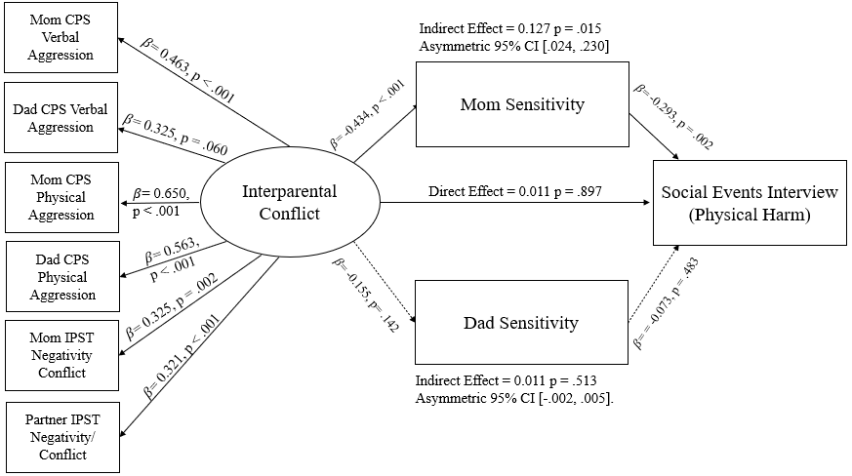

Expanding Applications of the Spillover Hypothesis: Interparental Conflict, Parenting, and Children’s Moral Development
Yoomin Hwang, Hannah Swerbenski, B.S., & Melissa Sturge-Apple, Ph.D.
Department of Psychology, University of Rochester, Rochester, NY
INTRODUCTION
OBJECTIVE
Interparental conflict (IPC) negatively impacts families across several domains, including reducing sensitivity in parents and prosocial behaviors in children^{1,2}
The Spillover Hypothesis³ suggests conflict in one familial relationship may permeate into others
By applying the Spillover Hypothesis to a new domain of child functioning, we test conflict-related reductions parenting sensitivity as mediators of associations between IPC and children’s moral development.
Examine maternal and paternal sensitivity as mediators of the impact of interparental conflict on children’s acceptability of psychological and physical harm in early childhood
MEASURES
Interparental Conflict Indicators (W1, child age 3):
  Conflict and Problem-Solving Scales⁴ (CPS): mothers and fathers self-reported on their verbal aggression and physical aggression
  Interparental Problem-Solving Task (IPST): observed Negativity/Conflict during the IPST, which asks parents to resolve two issues in their marriage through a verbal discussion, was behaviorally coded using the System for Coding Interactions in Dyads⁵ (ICCs > .782).
  Sensitivity (W2, child age 4): Parental sensitivity, the ability to accurately interpret and promptly respond to child signals, was observationally coded during the "Forbidden Toy Task." This task is a stressor/obligation paradigm designed to simulate the competing parental demands of the home environment. Maternal and paternal sensitivity were reliably coded (ICCs>.821) using the Caregiving Around Discipline System.⁶
Social Events Interview⁷ (W3, child age 5): Children’s moral development was assessed using interview vignettes regarding physical harm and psychological harm by asking children to rate level of wrongness of each action in the story, explain the reasoning behind the rating, and explain their understanding of the emotional effect the action had on the characters in the story.
PARTICIPANTS & RECRUITMENT
235 families (mothers, fathers, and their 3-year-old child) from the greater Rochester, NY area participated in 3 annual waves of assessments.
Families were recruited through school districts, online family forums, and flyers posted at local sites frequented by families. Children were 55.3% female.
Sample Characteristics
Race/Ethnicity
Parental Education
 | Mother | Father | Child
Black | 21.3% | 23.8% | 21.3%
White | 62.6% | 55.3% | 56.2%
Biracial | 7.7% | 7.7% | 16.2%
Asian | 2.6% | 1.7% | 1.7%
Native American/Pacific Islander | - | - | 0.4%
Other | 6% | 11.5% | 4.3%
 | High School or Less | Some College | Associate’s Degree | Bachelor’s or Higher
Mothers | 25.5% | 18.8% | 8.5% | 47.2%
Fathers | 35.3% | 17.9% | 9.4% | 22.5%
RESULTS & DISCUSSION
Physical Harm Model
Psychological Harm Model
Results show maternal sensitivity mediates the link between IPC and children’s moral development, especially in the domain of physical harm.
Paternal sensitivity did not act as a mediator between IPC and moral development
Results partially align with Spillover Hypothesis as interparental conflict permeated the mother-child relationship
The influence of mothers may have been stronger because mothers traditionally spend more time with their children than fathers,⁸ and thus may have more opportunities to influence children’s burgeoning moral development
This research can inform family-centered resources that support early moral development
ACKNOWLEDGEMENTS
REFERENCES
This research was supported by the University of Rochester Discover Grant.
This study (Project FLIGHT) was sponsored by the National Institute of Child Health and Human Development.
We would like to thank participating families at Mount Hope Family Center
Krishnakumar, A., & Buehler, C. (2000). Interparental conflict and parenting behaviors: A meta-analytic review. Family Relations, 49(1), 25-44. https://doi.org/10.1111/j.1741-3729.2000.00025.x
Kouros, C. D., Cummings, E. M., & Davies, P. T. (2010). Early trajectories of interparental conflict and externalizing problems as predictors of social competence in preadolescence. Development and psychopathology, 22(3), 527–537. https://doi.org/10.1017/S0954579410000258
Sturge-Apple, M., Davies, P., & Cummings, E.M. (2006). Hostility and withdrawal in marital conflict: Effects on parental emotional unavailability and inconsistent discipline. Journal of Family Psychology, 20(2), 227–238. https://doi.org/10.1037/0893-3200.20.2.227
Kerig, P. K. (1996). Assessing the links between interparental conflict and child adjustment: The conflicts and problem-solving scales. Journal of Family Psychology, 10(4), 454–473. https://doi.org/10.1037/0893-3200.10.4.454
Malik, N. M., & Lindahl, K. M. (2004). System for coding interactions in dyads (SCID). In Couple Observational Coding Systems (pp. 173-189). Routledge Taylor & Francis Group. https://doi.org/10.4324/9781410610843
Jones-Gordils, H., Sturge-Apple, M., & Davies. P. (2021). Maternal executive functions, maternal discipline, and children's school readiness: A process oriented approach. Journal of Child and Family Studies, 30, 1393-1405. http://doi.org/10.1007/s10826-021-01949-9
Smetana, J.G., Schlagman, N., & Walsh Adams, P. (1993). Preschool children’s judgments about hypothetical and actual transgressions. Child Development, 64(1), 202-214. http://doi.org/10.1111/j.1467-8624.1993.tb02904.x
Dotti Sani, G.M., & Treas, J. (2016). Educational gradients in parents’ child-care time across countries, 1965-2012. Journal of Marriage and Family, 78(4), 1083-1096. https://doi.org/10.1111/jomf.12305
Notes:
APS REQUIREMENTS
Size = 55.9” width x 42.1” height, landscape
Minimum of 24-28 font size, 32+ better for readability
Images as jpg with 72/96 dpi
File > save as > PDF

