Slide 1


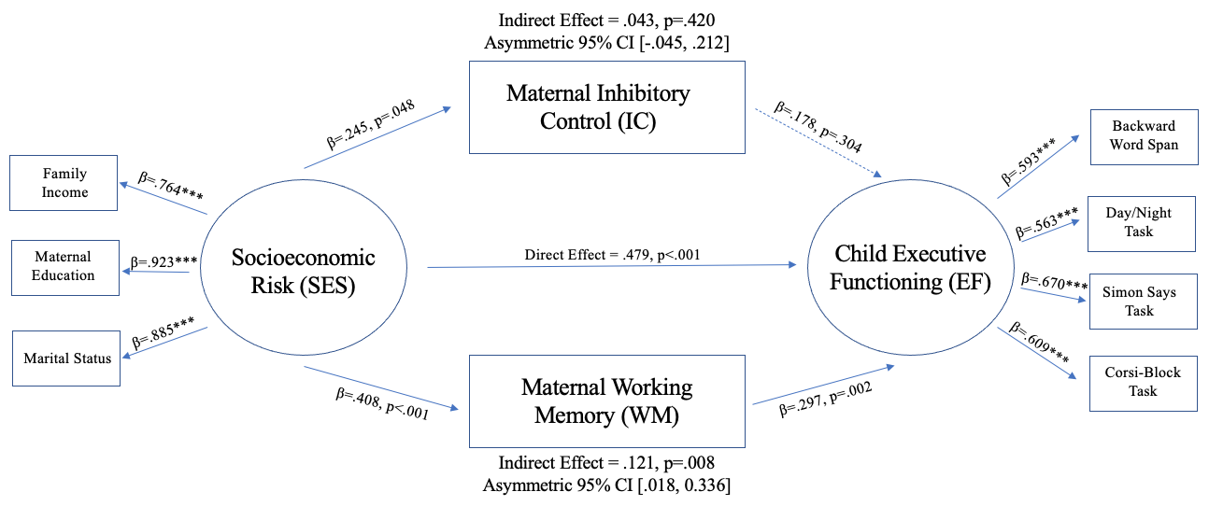
Cascading Effects of Early Socioeconomic Risk on Child Executive
Functioning Through Maternal Working Memory and Inhibitory Control
Grace Messina, Hannah Swerbenski, B.S., & Melissa Sturge-Apple, Ph.D.
Department of Psychology, University of Rochester, Rochester, NY
INTRODUCTION
MEASURES
DISCUSSION
Executive functions (EF) are cognitive processes that select, execute, and monitor behaviors and serve as the foundation for academic, social, and emotional competence.^{1,2}
Working memory (WM) is a resource for short-term manipulation and storage of information.^{3,4}
Inhibitory control (IC) suppresses irrelevant information in pursuit of goal attainment.^{3,4}
Socioeconomic status (SES) has caustic effects on early EF development.^{2,5,6}
Low SES mothers also exhibit poorer EF abilities compared to middle/high SES mothers.⁷
Genetics influence EF, with maternal EF being positively correlated with child EF.^{6,7,8}
Socioeconomic Risk (SES) - Wave 1
  Mt. Hope Demographic Interview⁹: commonly used in studies at Mt. Hope Family Center with high-risk populations.
Maternal Executive Functioning (Maternal EF) - Wave 2
  Stop-Signal Paradigm¹⁰: measure of IC, respond as quickly as possible to predetermined stimulus and avoid responding when stop signal is displayed.
  Digit Span Task¹¹: measure of WM, recall a string of numbers in forward/reverse order.
Child Executive Functioning (Child EF) - Wave 3
  Backwards Word Span¹²: measure of verbal WM, recall target words in reverse order from which they were presented.
  Day/Night Task¹³: measure of IC, respond with word that is opposite of displayed picture.
  Simon Says Task¹⁴: measure of IC, respond only when “Simon says” precedes command.
  Corsi-Block Task¹⁵: measure of spatial WM, mimic patterned sequence by tapping nine identical boxes.
Results indicate that maternal WM, but not maternal IC, mediate associations between SES and child EF.
Emergence of heritability in EF becomes increasingly evident with mother-child WM associations appearing prior to and stronger than mother-child IC associations.¹⁶
Difference in expression results from increased capacity of WM and subsequent utilization of IC resources.¹⁷
REFERENCES
Hughes, C. et al. (2004). Executive function in childhood: Development and disorder. Cognitive Development, 205-230.
Ursache, A. et al. (2013). Emotional reactivity and regulation in infancy interact to predict executive functioning in early childhood. Developmental Psychology, 49(1), 127-137.
Deater-Deckard, K. Family Matters: Intergenerational and Interpersonal Processes of Executive Function and Attentive Behavior. Association of Psychological Science, 23(3), 230-236.
Roberts, R.J. Jr. et al. (1994). Prefrontal cognitive processes: Working memory and inhibition in an anti-saccade task. Journal of Experimental Psychology: General, 123, 372-393.
Evans, G.W. et al. (2005). The role of chaos in poverty and children’s socioemotional adjustment. Psychological Science, 16(7), 560-565.
Kao, K. et al. (2018). Relations between parent EF and child EF: The role of socioeconomic status and parenting on executive functioning in early childhood. Translational Issues in Psychological Science, 4(2), 122-137.
Sturge-Apple, M.L. et al. (2017). When Stress Gets Into Your Head: Socioeconomic Risk, Executive Functions, and Maternal Sensitivity Across Childrearing Contexts. Journal of Family Psychology, 31(2), 160-169.
Yan, N. (2016). Children’s resilience in the presence of mother’s depressive symptoms: Examining regulatory processes related to active agency. Children and Youth Services, 61, 90-100.
Cicchetti, D. & Carlson, V. (1979). Demographics interview. Unpublished measure, available from D. Cicchetti, University of Minnesota.
Verbruggen, F. et al. (2008). STOP-IT: Windows executable software for the stop-signal paradigm. Behavior Research Methods, 40, 479-483.
Wechsler, D. (2008). Digit Span Forward, Backward, and Sequencing Tasks from the Wechsler Adult Intelligence Scale – Fourth Edition (WAIS-IV). San Antonio, TX: NCS Pearson.
Weschler, D. (2011) Wechsler Abbreviated Scale of Intelligence – Second Edition (WASI-II). San Antonio, TX: NCS Pearson.
Gerstadt, C.L. et al. (1994). The relationship between cognition and action: performance of children 312-7-year-olds on a stroop-like day-night test. Cognition, 53(2), 129-153.
Carlson, S.M. & Wang, T.S. (2007). Inhibitory control and emotion regulation in preschool children. Cognitive Development, 22(4), 489-510.
Corsi, P.M. (1972). Human memory and the medial temporal region of the brain (Doctoral dissertation, McGill University)
Cuevas, K. et al. (2013). A longitudinal intergenerational analysis of executive functions during early childhood. British Journal of Developmental Psychology, 32, 50-64.
Roncadin, C. et al. (2007). Developmental relations between working memory and inhibitory control. Journal of the International Neuropsychological Society, 13, 59-67.
OBJECTIVE
Examine how maternal WM and maternal IC mediate associations between SES and child EF through a longitudinal secondary analysis.
RESULTS
PARTICIPANTS
152 mother-child dyads from the greater Rochester, NY area.
Median family income was $33,400 with one third reporting annual income below $23,000.
Children were 17-19 months at Wave 1, 3.5 years at Wave 2, and 5 years old at Wave 3.
BLAH
B
B
B
D
B
B
B
B
Sample Characteristics
Race/Ethnicity
Maternal Education
 | Mother | Child
Black | 36.2% | 36.2%
White | 55.9% | 47.4%
Biracial | 3.3% | 13.2%
Other | 8.0% | 3.3%
Latino | 11.8% | 15.8%
Less than HS | 18.4%
HS Diploma/ GED | 19.0%
Vocational/Tech/ Partial College | 11.2%
Associate’s Degree | 7.2%
Bachelor’s Degree | 25.0%
Master’s Degree | 17.1%
Doctoral Degree | 2.0%
ACKNOWLEDGEMENTS
This research was supported by the Meliora Psychology Research Fellowship.
The original research study (Project CONNECT) was sponsored by the National Institute of Nursing Research.
The authors would like to thank participating families at Rochester’s Center for Research on Children and Families.
Notes:
Expo title = Maternal executive function partially mediates effects of early socioeconomic risk on child executive functioning
APS REQUIREMENTS
Size = 55.9” width x 42.1” height, landscape
Minimum of 24-28 font size, 32+ better for readability
Images as jpg with 72/96 dpi
File > save as > PDF

